Slide 1
ACTIVITY RECOGNIZER
De Marco Angelo, Pardini Marco
Data Mining and Machine Learning project
2022/2023

Slide 2
Project workflow
EXPLORATORY DATA ANALYSIS
SMOOTHING FILTERS
FEATURE EXTRACTION
FEATURE REDUNDANCY
NEW DATASET CREATION
Preliminary Phases
1
2
3
4
5
Core Phases
6
7
8
9
FEATURE SELECTION
CUSTOM CROSS VALIDATION
CLASSIFIERS COMPARISON
EVALUATION ON NEW PHONE DATA

Slide 3
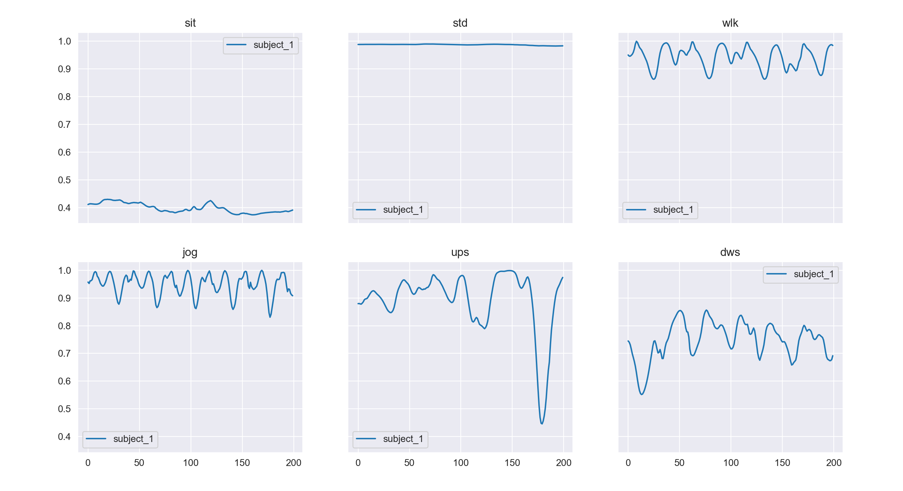
“A_Device_motion_data”
Time-series generated by accelerometer and gyroscope sensors
Iphone 6s kept in partecipants’ front pocket
24 partecipants in a range of gender, age, weight and height
6 activities: sitting, standing, walking, jogging, going upstairs and downstairs
15 trials for each activity in the same environment and conditions

Slide 4
PRELIMINARY PHASES
EXPLORATORY DATA ANALYSIS
We analyse class distribution and search if there are some unusual behaviours in some trials
Smoothing filters
We test some S.G. parameters to find a smoothing filter that keeps approximatively the true peak height (low smooth ratio)
Feature extraction
We segment all signals in fixed not-overlapping windows. From each segment we compute some time-domain features and some frequency-domain features.
Feature redundancy
We try to find if some extracted feature are redundant and so not useful for further phases.

Slide 5
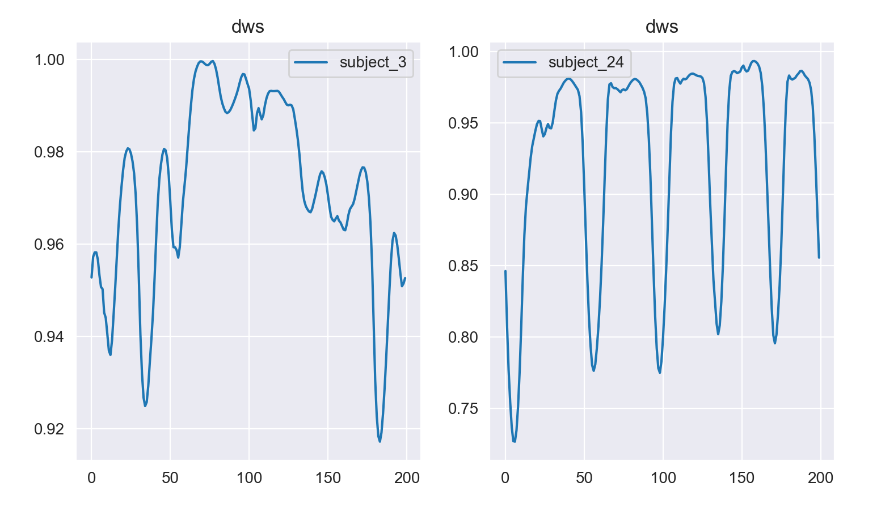
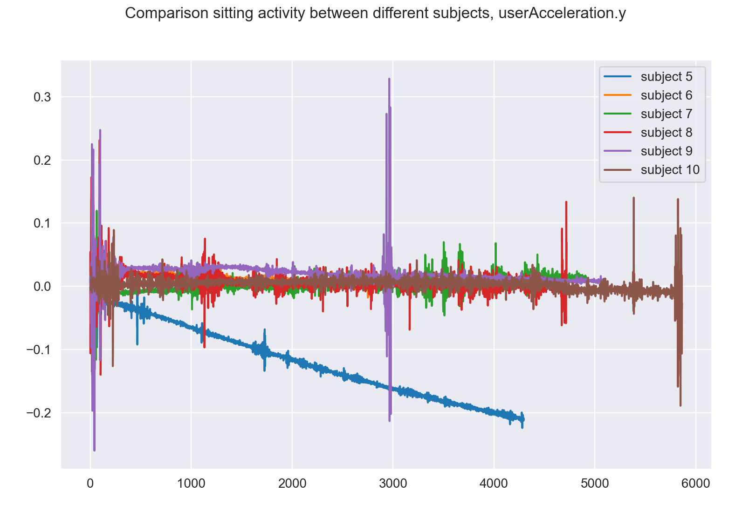
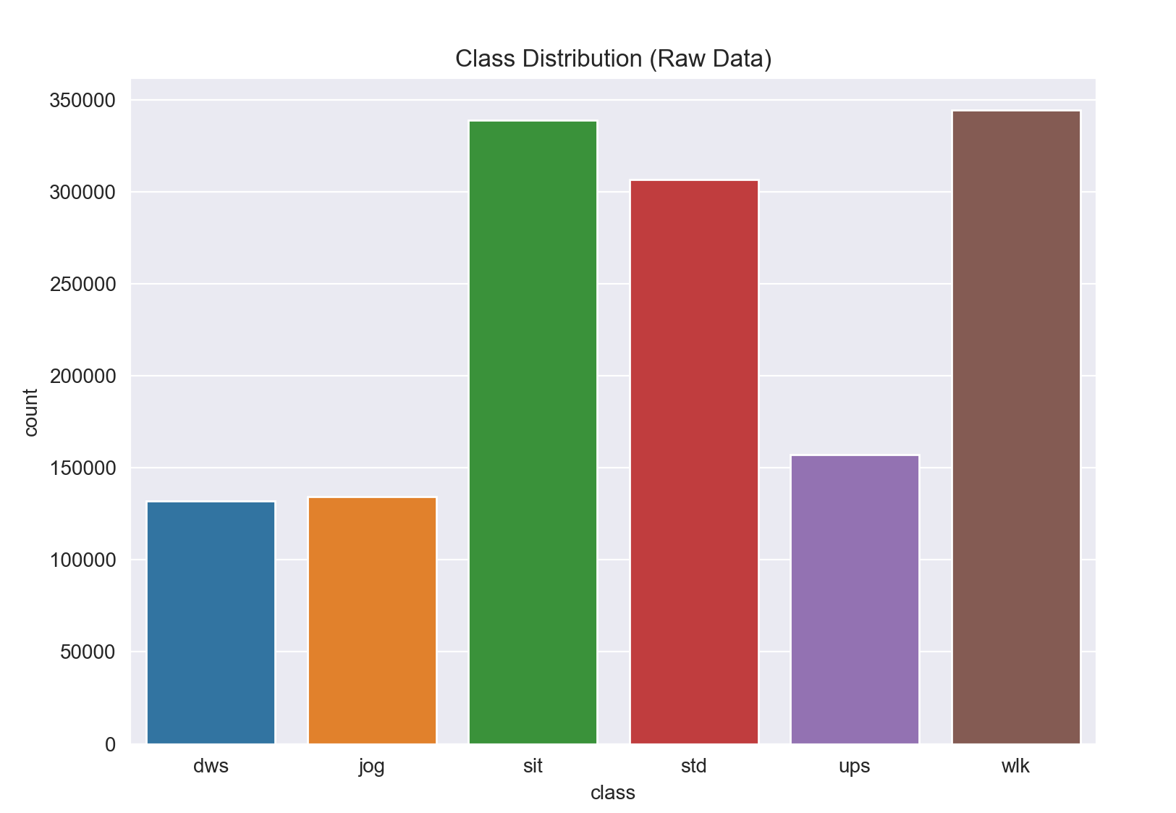
Exploratory analysis
Differences in same activity for different subjects
Differences in class distribution
No null values
Strange behaviours

Slide 6
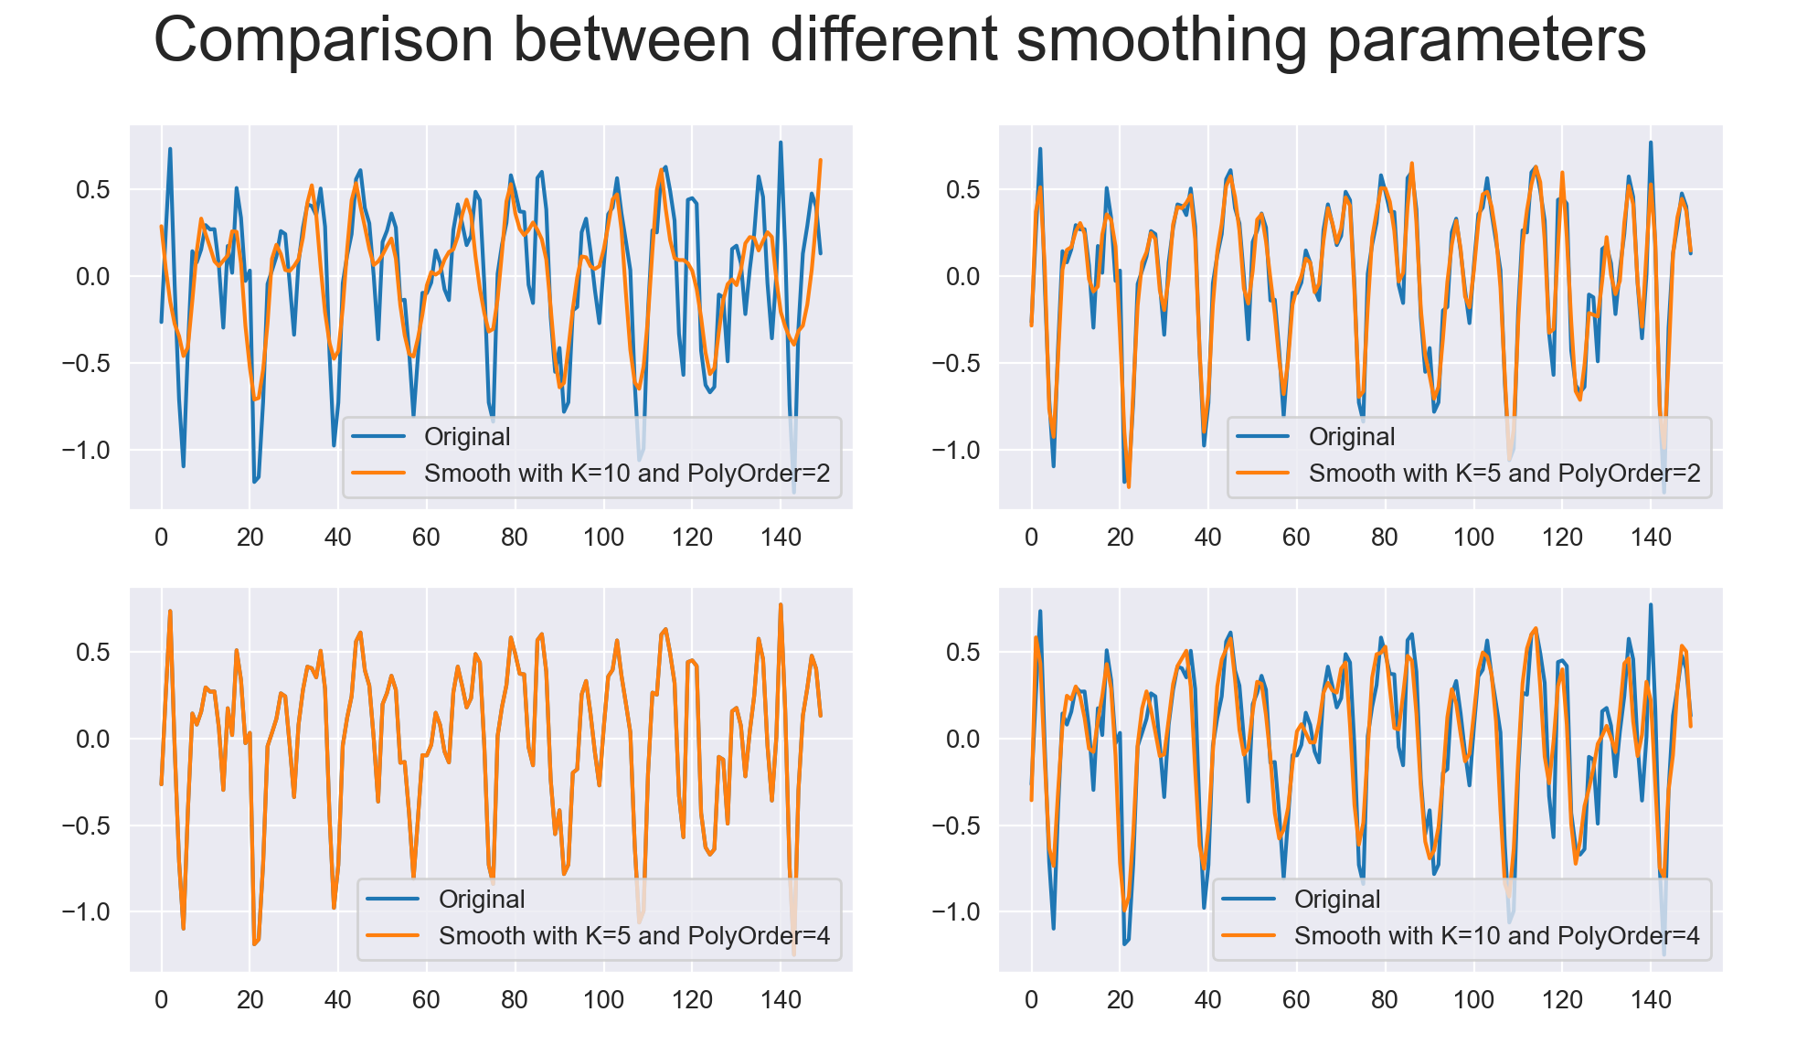
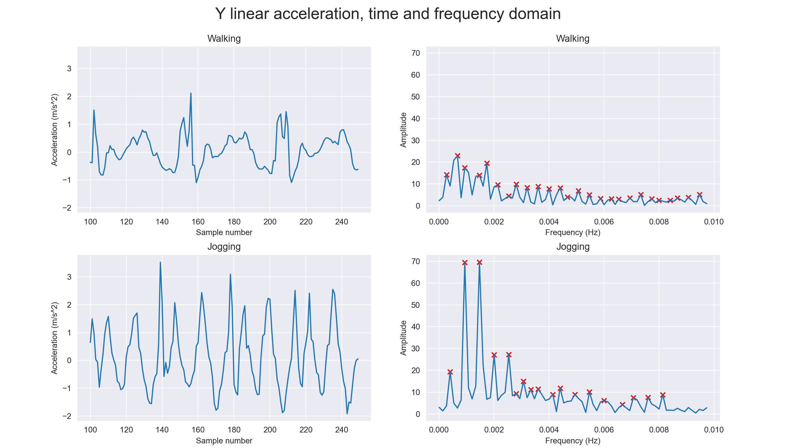
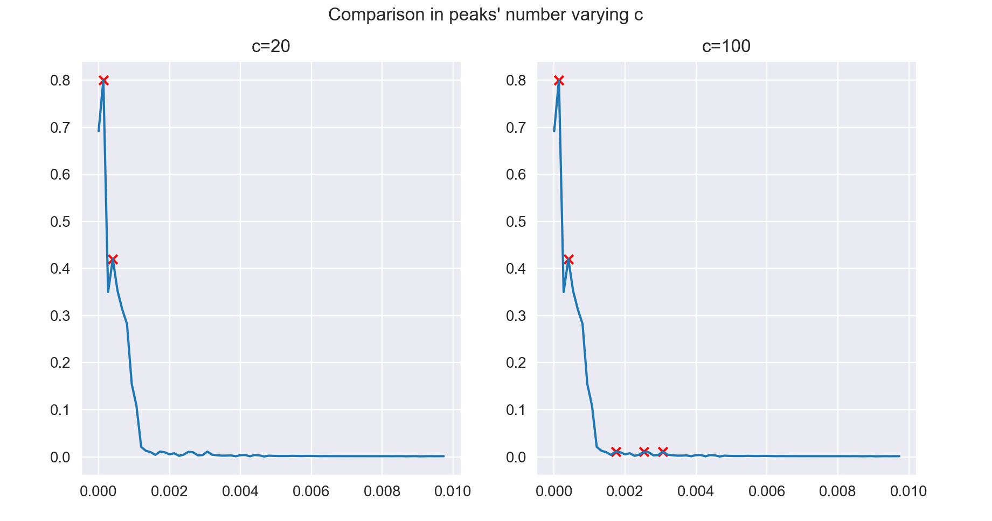
SMOOTHING AND FFT TRANSFORM
Want to preserve the true height of the signal
Not all FFT have all peaks we need

Slide 7
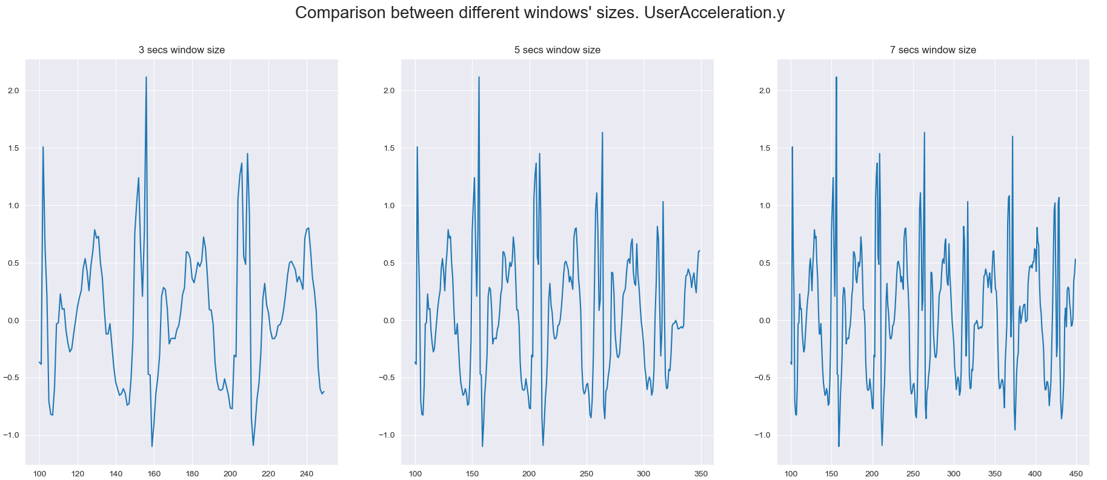
FEATURE EXTRACTION AND WINDOW SIZE
Segment each signal in non-overlapping windows
For each window, we create a single record in the new dataset
At the end of the process, we have around 8800 records
Time domain | Frequency domain
Mean, standard deviation, range, interquartile range, kurtosis, skewness | First 5 peaks’ position and amplitude
Total features: 147

Slide 8
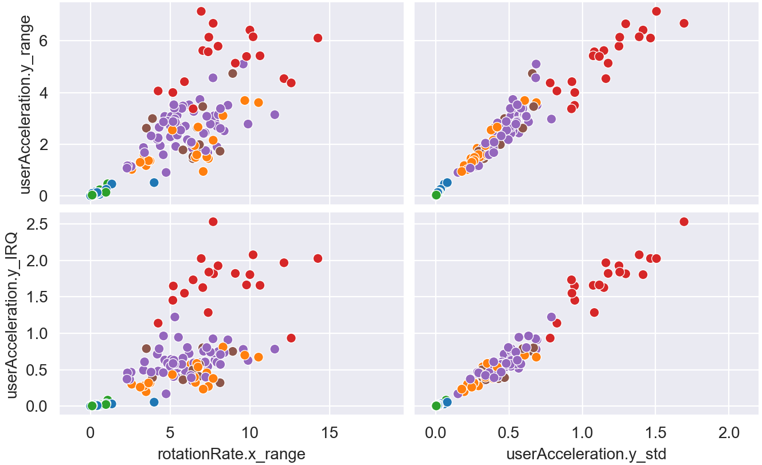
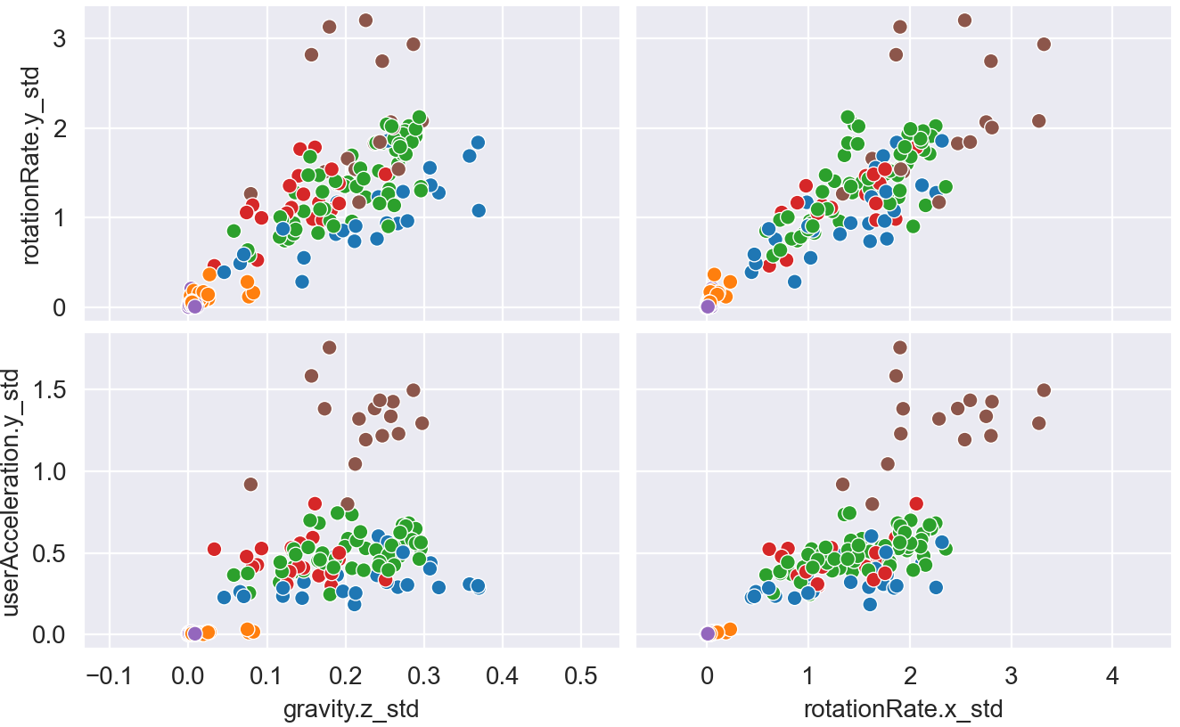
FEATURE REDUNDANCY
Looking at the most correlated features without no further processing, we noticed some highly correlated features
We use Pearson’s Correlation Matrix to have a first selection on them
Before Redundancy Check
AFTER Redundancy Check

Slide 9
Core phases
Feature selection
We want to determine which are the best (K) feature, and here we tune the K parameter
Custom cross Validation
For avoid overfitting-risk, we implement a leave-one-subject-out
Classifiers comparison
We compare a number of classifiers of various types, including an ensemble method and a lazy learner. We select from this phase the one with better results
Final evaluation on our phone data
In this final test, we use data from our personal phone and we test the previous selected model on this unseen data

Slide 10
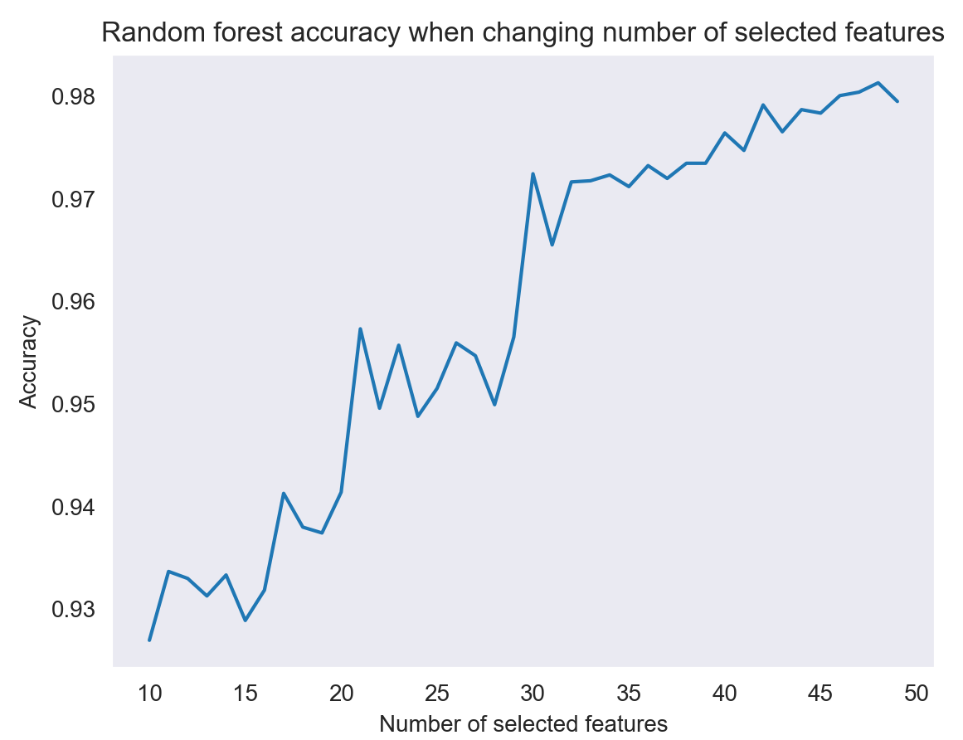
Feature selection
Random Forest Classifier to tune K parameter
We select the first K that gives accuracy a significant spike

Slide 11
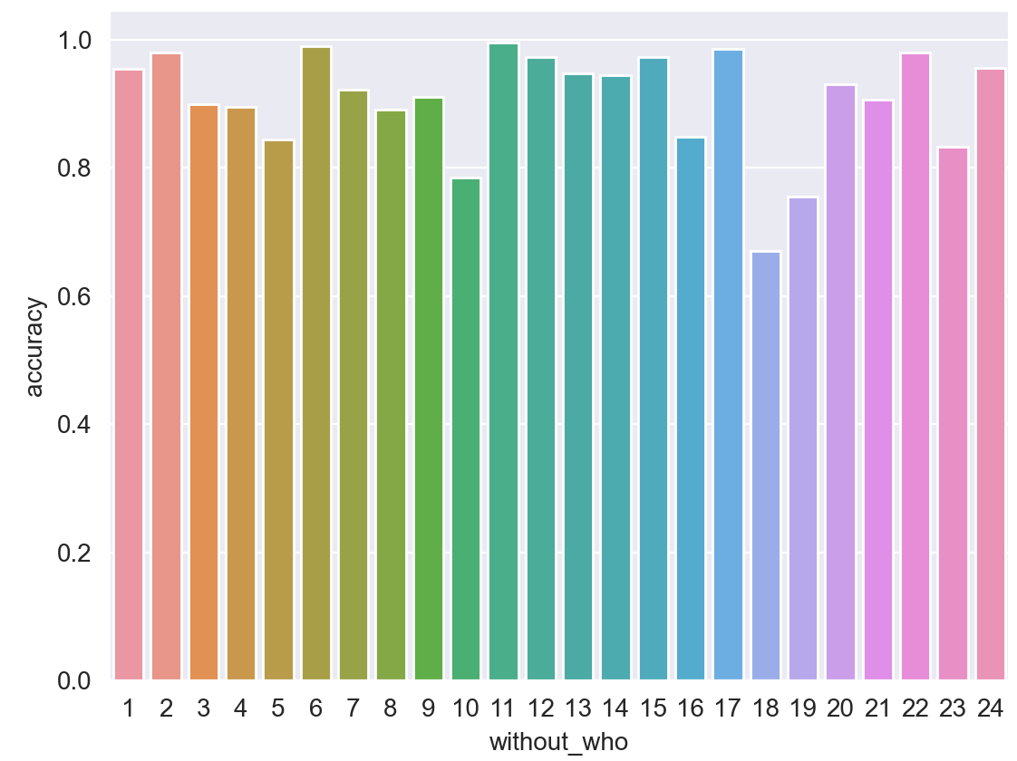
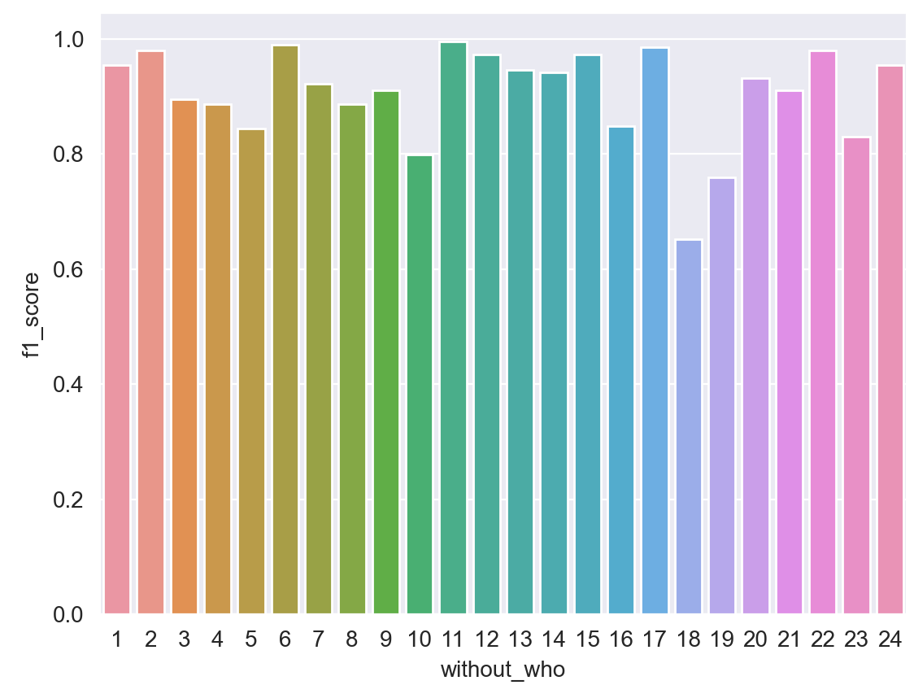
CUSTOM CROSS VALIDATION
Accuracies and f1_scores of folds with leave-one-subject-out strategy
Classic cross validate
Accuracy and F1_Score greater than 97%
We have overfitting risk
Maybe considering a subject only on the train or only on the test is a better idea

Slide 12
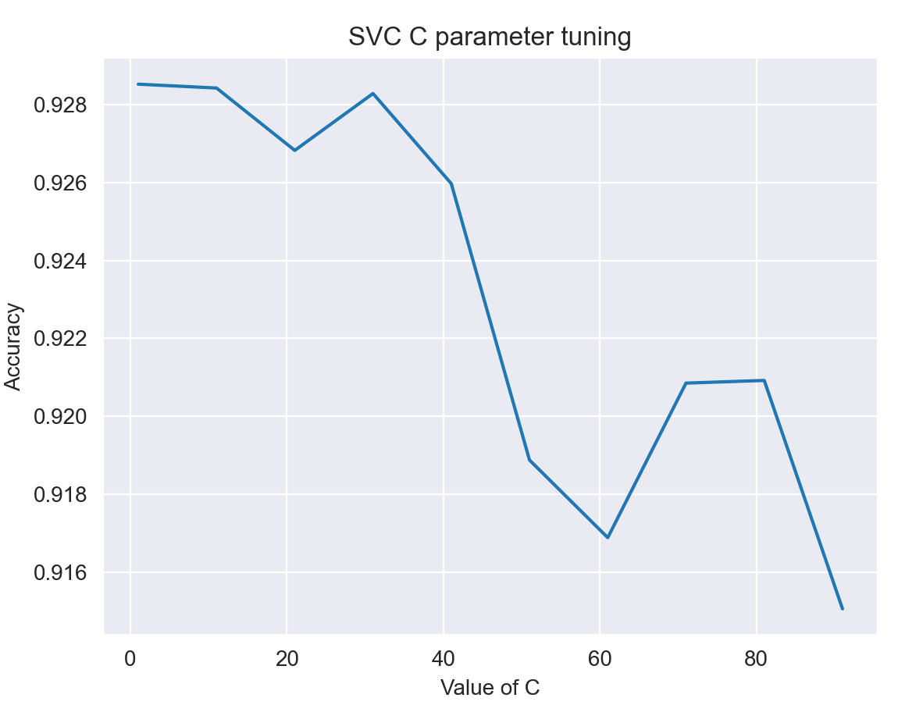
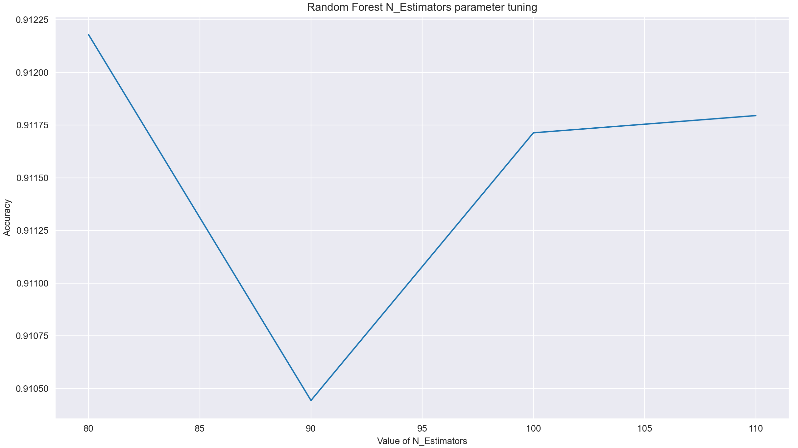
Classifier comparison
Experimental Results
 | Accuracy | Precision | Recall | F1_score
Random Forest Classifier | 0.91 | 0.94 | 0.91 | 0.91
Logistic Regression | 0.90 | 0.93 | 0.90 | 0.90
Decision Tree | 0.84 | 0.87 | 0.85 | 0.85
KNN-Classifier | 0.86 | 0.90 | 0.87 | 0.88
SVC | 0.92 | 0.94 | 0.92 | 0.92
GaussianNB | 0.70 | 0.76 | 0.70 | 0.72

Slide 13
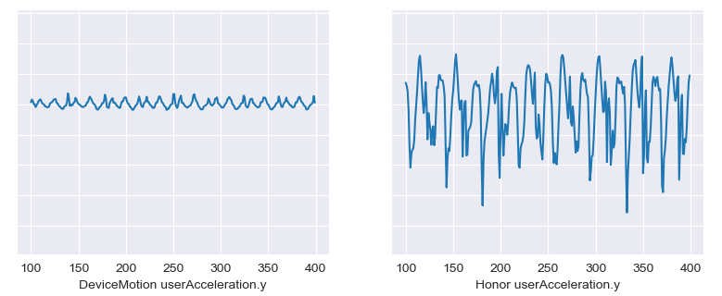
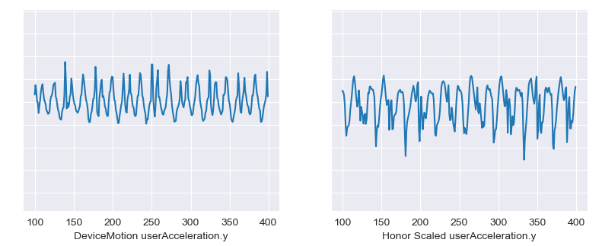
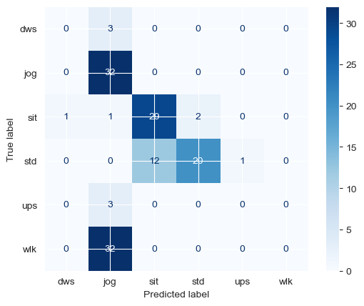
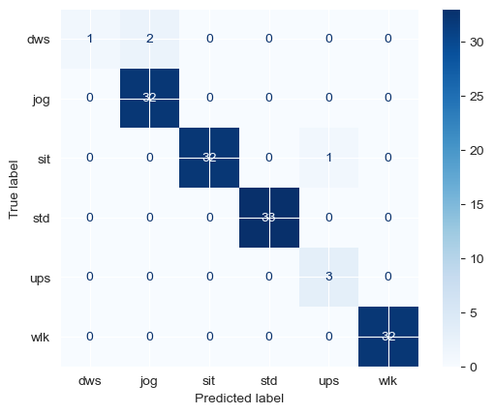
FINAL EVALUATION ON OUR PHONE DATA
BEFORE SCALING
AFTER SCALING

Slide 14
THANK YOU
Angelo De Marco, Marco Pardini

